Slide 1
Charter International School
Parent Orientation 2019
Welcome to
Year 5

Slide 2
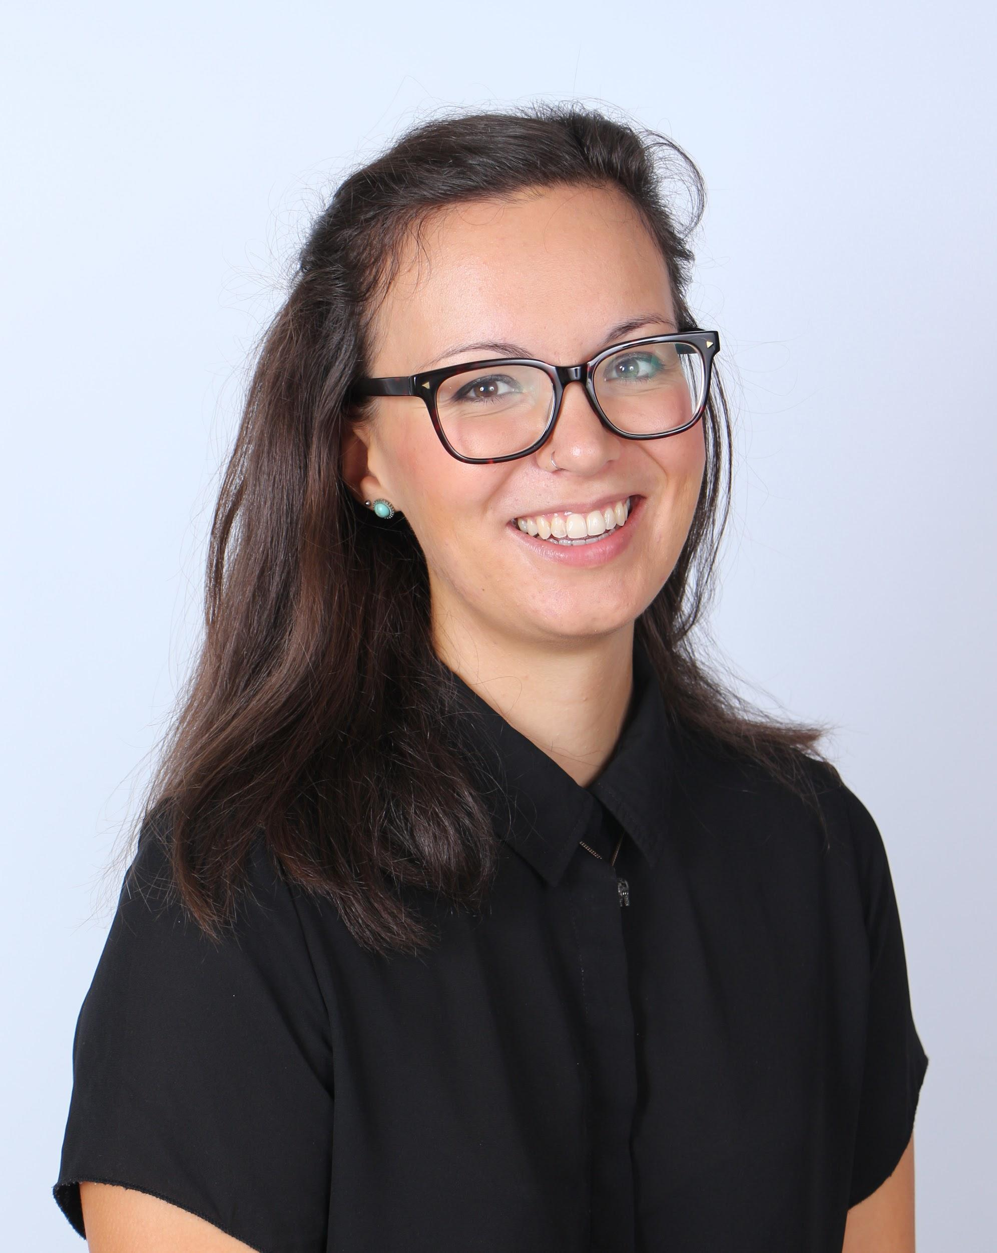
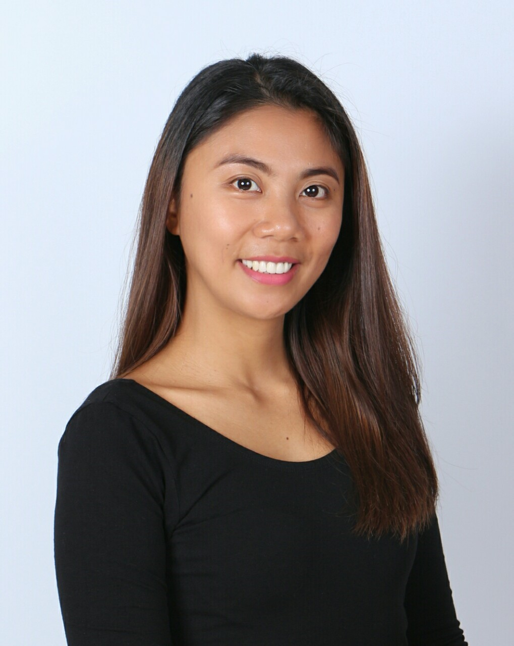
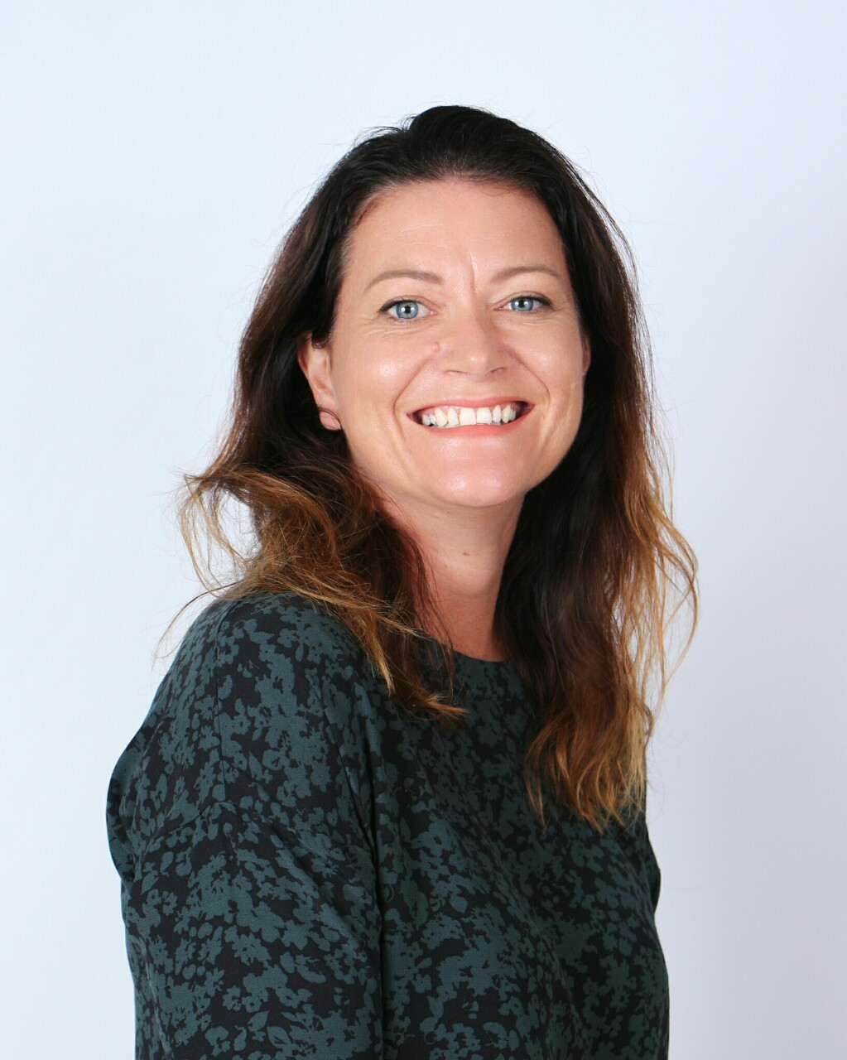
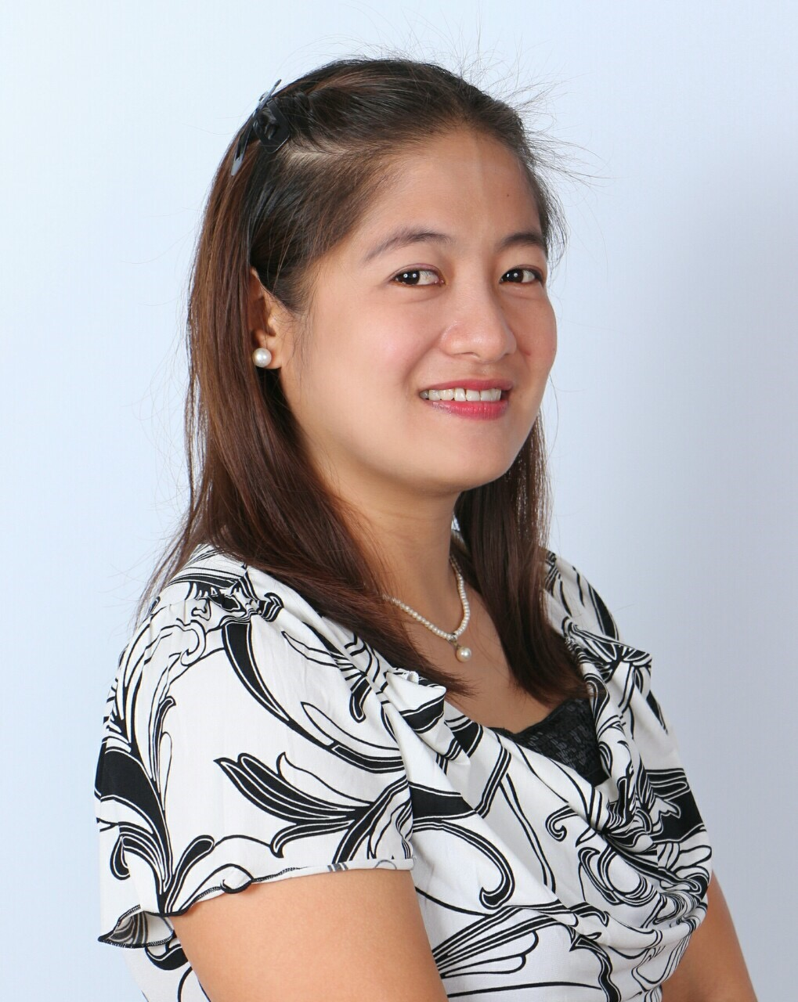
Charter International School
Parent Orientation 2019
Meet the team...
Class 5D
Class 5S
Ms Louise Ms Rhodz
Ms Downes
Ms Cris

Slide 3
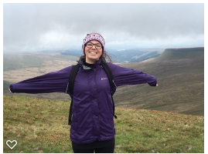
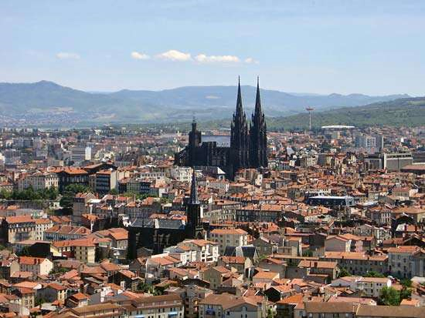
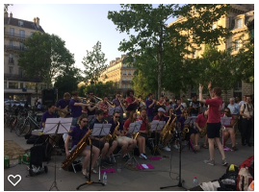
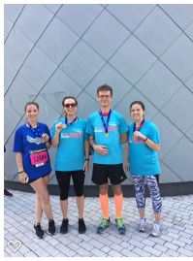
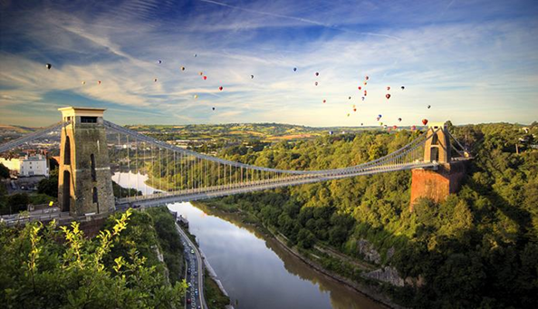
Charter International School
Parent Orientation 2019
Ms Downes...

Slide 4
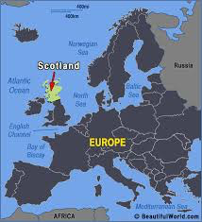
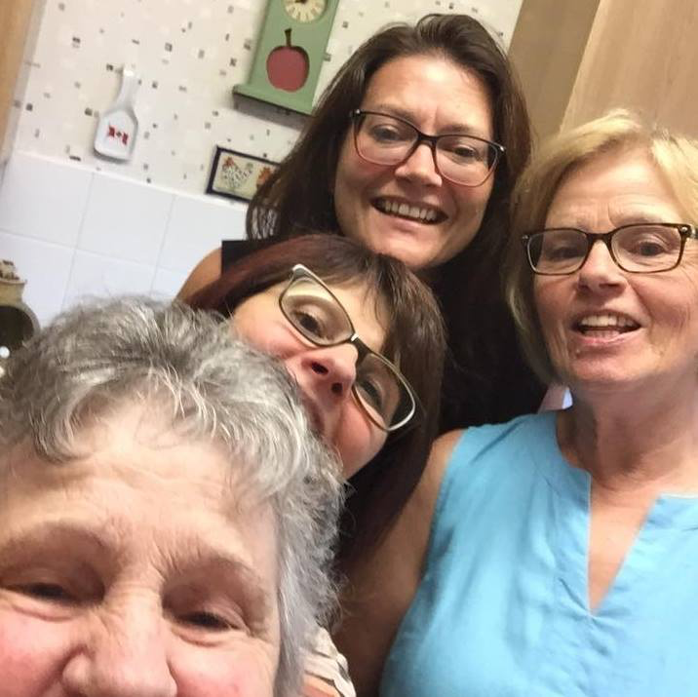
Charter International School
Parent Orientation 2019
Ms Louise...

Slide 5
Charter International School
Parent Orientation 2019
Communication...
Communication books
Class Blogs
Termly newsletter
Talk to the office
Pop in and see us
Email:
rdownes@charter.ac.th
lstout@charter.ac.th

Slide 6
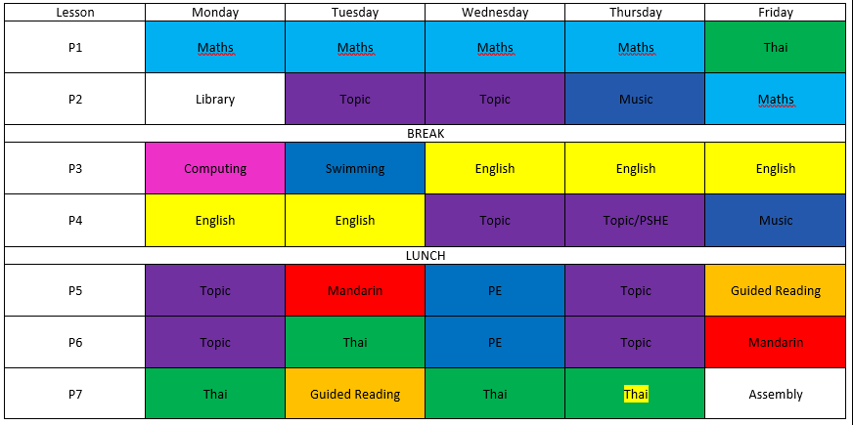
Charter International School
Parent Orientation 2019
Timetables...
5D

Slide 7
Charter International School
Parent Orientation 2019
Timetables...
5S

Slide 8
Charter International School
Parent Orientation 2019
Year 5 Topics...
Term 1.1:
Brainwaves
Space Explorers
Term 1.2:
What a Wonderful World
Term 2.1:
Existing, Endangered, Extinct
Term 2.2:
Roots, Shoots and Fruits
Bake it!
Term 3:
AD 900 Ancient Civilisations

Slide 9
Charter International School
Parent Orientation 2019
Homework...

Slide 10
Charter International School
Parent Orientation 2019
Trips...
Two local area trips
Linked to Topic work
Year 5 residential
iCamp Thailand, Kanchanaburi
11th-13th March 2020
More information nearer the time
https://www.icampthailand.com/copy-of-home

Slide 11
Charter International School
Parent Orientation 2019
Birthdays...
Parties
Please contact us before
Healthy school…
Plastic free school

Slide 12
Charter International School
Parent Orientation 2019
Reminders...
Lanyards
Line up at 7.50am
School uniform
Communication books
Update contact info at office

